Slide 1
CNENGR228 Tutorial 3
Dr Zhongming Zhang
1
Notes:
Today, we'll practise reading and checking VHDL code. We'll start with a few small errors, then look at signals, variables and delta cycles. For each question, try to explain why you chose your answer.

Slide 2
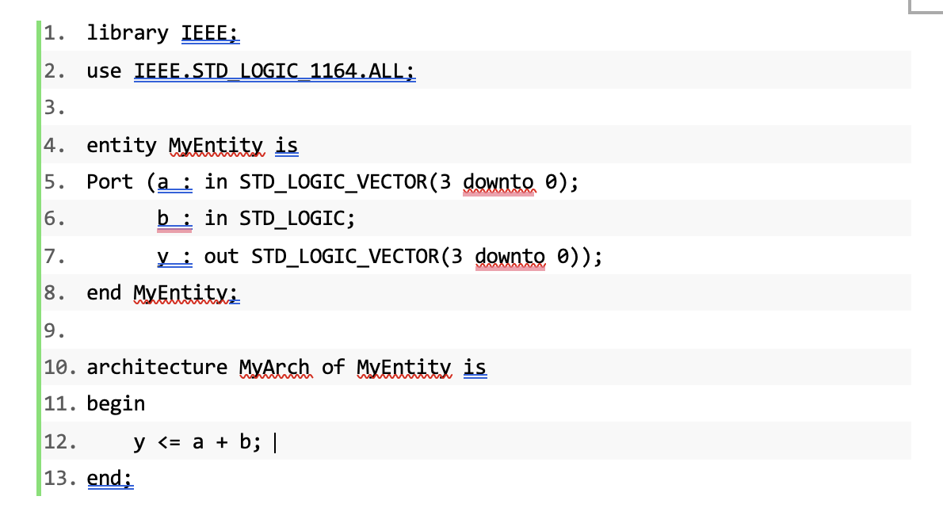
Q1 Arithmetic types
Identify the arithmetic error and repair it.
2
Notes:
Let's look at this code. We want to add the single bit b to the four-bit unsigned value a, and keep the lower four bits. Can we use the plus sign with these types and this package? How would you fix the arithmetic?

Slide 3
Q1 Answer
Use NUMERIC_STD and unsigned arithmetic
use IEEE.NUMERIC_STD.ALL;
y <= std_logic_vector(
unsigned(a) + unsigned'(0 => b));
The result keeps four bits: 1111 + 1 = 0000.
end; is valid. The architecture name is optional.
3
Notes:
The problem is the addition. STD_LOGIC_1164 does not provide a suitable plus operation here. We can use NUMERIC_STD and convert a and b to unsigned values. The expression on the right makes b a one-bit unsigned value. Then we convert the result back to a standard logic vector. We keep four bits, so fifteen plus one wraps back to zero. Also, end followed by a semicolon is valid. Adding the architecture name is optional.
References (not spoken):
https://www.vhdl-online.tu-chemnitz.de/vhdl_reference_93/architecture
https://github.com/ghdl/ghdl/blob/master/libraries/ieee2008/numeric_std.vhdl

Slide 4
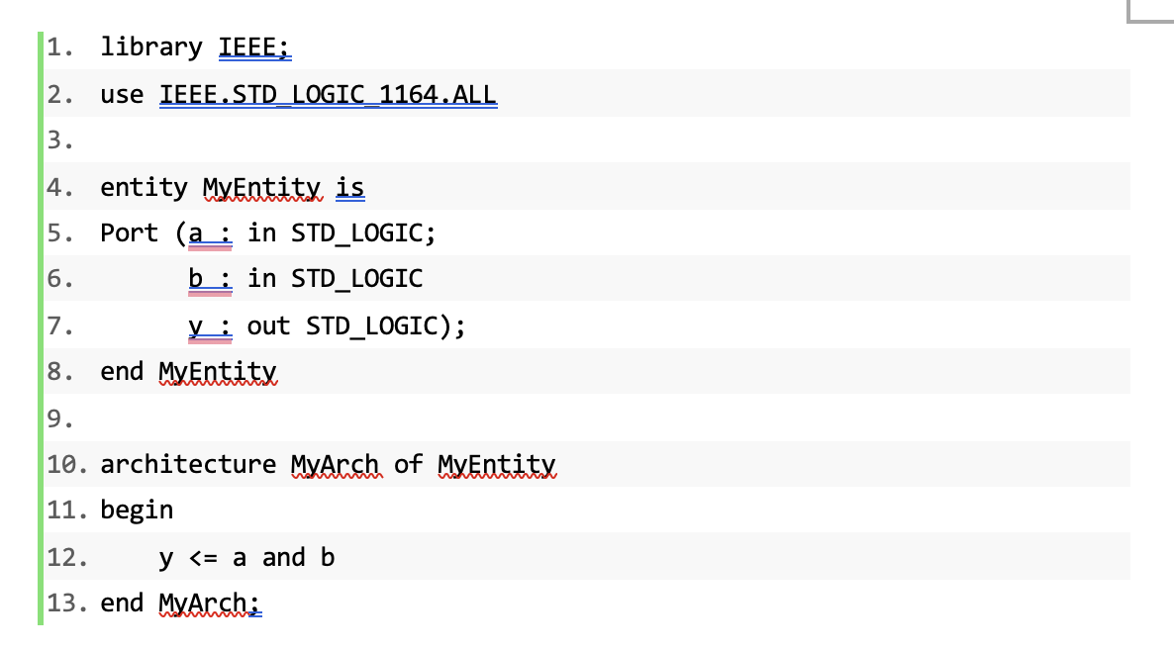
Q2 Missing syntax
Find all five syntax errors.
4
Notes:
This code should describe a simple AND gate, but some syntax is missing. Find all five errors. Check the ends of the statements and the architecture declaration. The vertical cursor in the screenshot is not part of the code.

Slide 5
Q2 Answer
Five repairs
Original line | Repair
2 | Add ; after the use statement
6 | Add ; after the declaration of b
8 | Add ; after end MyEntity
10 | Add is
12 | Add ; after y <= a and b
Result: an AND gate
5
Notes:
We need four semicolons: after the use statement, after the declaration of b, after end MyEntity, and after the assignment to y. We also need the word is at the end of the architecture declaration. With these changes, the code describes an AND gate.

Slide 6
Q3 Multiplexer syntax
Find four errors and state the function.
1 library IEEE;
2 use IEEE.STD_LOGIC_1164.ALL;
4 entity Mux is
5 port(a, b : in std_logic;
6 sel : in std_logic,
7 y : out std_logic);
8 end Mux
10 architecture Behav of Mux
11 begin
12 process(a b, sel)
13 begin
14 if sel = '0' then
15 y <= a;
16 else
17 y <= b;
18 end if;
19 end process;
20 end Behav;
6
Notes:
Now check this multiplexer. There are four syntax errors. Look at the port list, the entity ending, the architecture declaration and the process sensitivity list. Once you've fixed them, explain how sel controls the output.

Slide 7
Q3 Answer
Four repairs
Original line | Repair
6 | Replace the comma with ;
8 | Add ; after end Mux
10 | Add is
12 | Use process(a, b, sel)
sel = '0': y = a
sel = '1': y = b
7
Notes:
In the port list, the comma after sel must be a semicolon. We also need a semicolon after end Mux, and the word is after the architecture declaration. In the sensitivity list, we need a comma between a and b. For normal zero and one inputs, sel equal to zero selects a. Sel equal to one selects b.

Slide 8
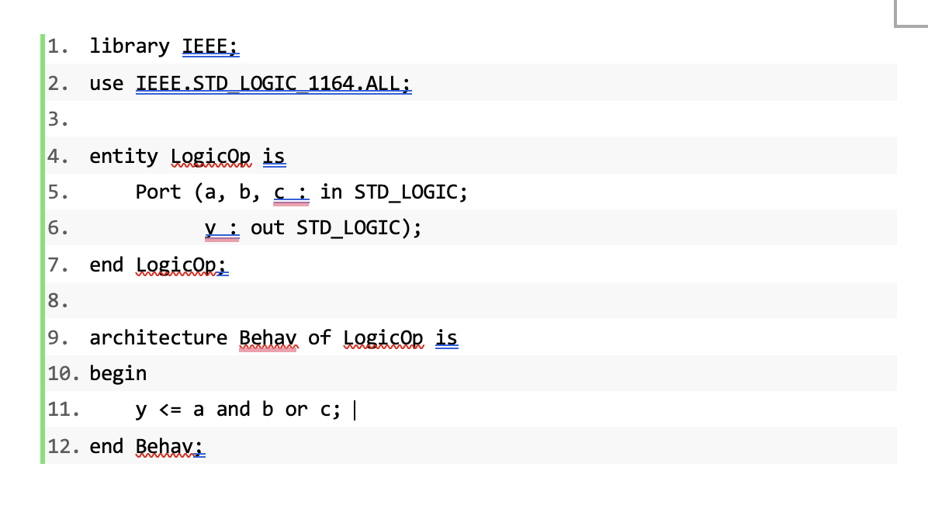
Q4 Mixed logical operators
Repair the expression for y = (a AND b) OR c.
8
Notes:
Here, the intended function is a AND b, then OR with c. Look at the assignment in the screenshot. Is this expression valid VHDL? Add the brackets needed to describe the intended function.

Slide 9
Q4 Answer
Use brackets to group the intended function
y <= (a and b) or c;
Different brackets give a different function:
y <= a and (b or c);
Example: a = 0, b = 0, c = 1 gives 1 in the first case and 0 in the second.
9
Notes:
In VHDL, we need brackets when we mix and and or like this. For the intended function, put brackets around a AND b. Moving the brackets changes the function. For example, when a and b are zero and c is one, the first expression gives one, but the second gives zero. So the brackets affect both the syntax and the meaning.
References (not spoken):
https://www.vhdl-online.tu-chemnitz.de/courses/system_design/vhdl_language_and_syntax/operators

Slide 10
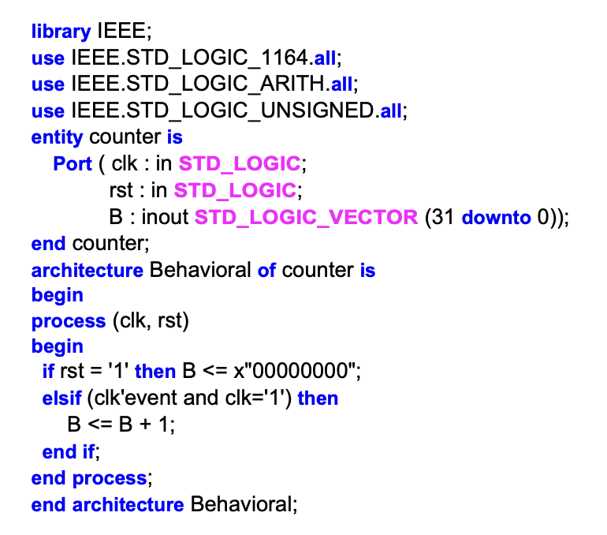
Q5 Counter behaviour
Assume the legacy packages are available.
1. What are the width and count direction?
2. Is reset synchronous or asynchronous?
3. What does x"00000000" mean?
4. What follows x"FFFFFFFF"?
Assume reset has occurred and B has no external driver.
10
Notes:
Let's read this counter. Assume the older arithmetic packages are available, reset has happened, and nothing outside the circuit drives B. How many bits does it have? Does it count up or down? Does reset need a clock edge? Also, explain the hexadecimal values in the question.

Slide 11
Q5 Answer
32-bit up-counter, active-high asynchronous reset
-- NUMERIC_STD version: clocked process fragment
if rst = '1' then
count <= (others => '0');
elsif rising_edge(clk) then
count <= count + 1;
end if;
count is unsigned(31 downto 0).
x"00000000" means 32 zero bits.
x"FFFFFFFF" + 1 wraps to zero.
Use an internal count signal, with B as an output.
11
Notes:
This is a thirty-two-bit up-counter. Reset is active high and asynchronous, so it clears the count without waiting for a clock edge. Each rising edge then adds one. The x introduces a hexadecimal bit string. Eight hexadecimal digits give thirty-two bits. After all bits are one, the next count wraps to zero. The version here uses NUMERIC_STD and an internal unsigned signal. B only needs to be an output. The older version can work in tools that support its packages.

Slide 12
Q6 Circuit interpretation
Draw the circuit and state the reset behaviour.
signal x, y : std_logic;
-- a, b, c, clk, reset and q are std_logic ports
begin
x <= a and b;
y <= x or c;
process(clk, reset)
begin
if reset = '1' then
q <= '0';
elsif rising_edge(clk) then
q <= y;
end if;
end process;
12
Notes:
For this question, read the code as hardware. Draw the logic for x and y first. Then look at the process and decide what stores the result. Make sure your drawing includes the clock and reset, and explain what reset does.

Slide 13
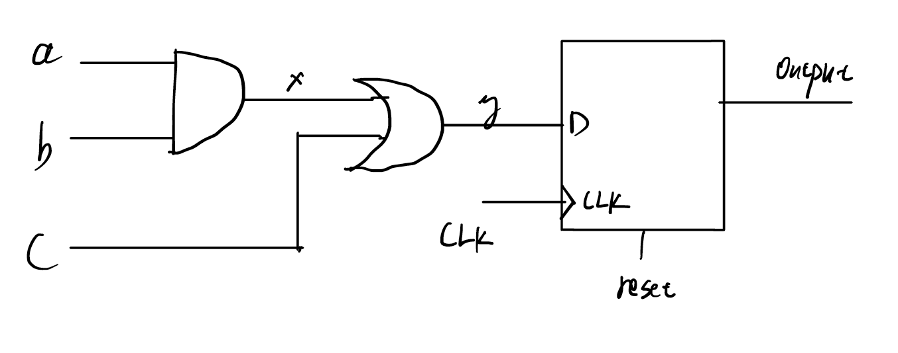
Q6 Answer
AND gate + OR gate + D flip-flop
reset = 1: q clears to 0 without a clock edge.
Otherwise, each rising edge stores (a AND b) OR c in q.
13
Notes:
First, an AND gate combines a and b to make x. An OR gate combines x and c to make y. A D flip-flop stores y in q on each rising clock edge. When reset is high, q clears to zero without waiting for the clock. For normal sampling, we assume the inputs and the combinational logic have settled before the edge.

Slide 14
Q7 Assignment operators
Repair two assignments, then predict y.
-- clk is a std_logic input.
-- y is an integer signal, initially 0.
process(clk)
variable v : integer := 0;
begin
if rising_edge(clk) then
v <= v + 1;
y := v;
end if;
end process;
Predict y after the first and second rising edges.
The process variable keeps its value between activations.
14
Notes:
This process contains one variable, v, and one signal, y. Two assignment operators are wrong. Correct them first. Then work out y after the first and second rising edges. Remember that the process variable keeps its value between activations.

Slide 15
Q7 Answer
Use := for the variable, and <= for the signal
v := v + 1;
y <= v;
Edge | v | y
1 | 1 | 1
2 | 2 | 2
v changes immediately. y updates afterwards.
v keeps its value between activations.
15
Notes:
A variable uses colon-equals, and a signal uses the signal assignment operator. At the first edge, v changes from zero to one straight away. The next statement reads that new value and schedules one for y. At the second edge, v becomes two and y later becomes two. The declaration sets the starting value of v only once. It does not reset v on every edge.

Slide 16
Q8 Complete combinational assignment
Does this code describe a complete multiplexer?
-- a, b, sel and y are std_logic.
process(a, b, sel)
begin
if sel = '1' then
y <= a;
end if;
end process;
What happens when sel = 0?
Rewrite the process so y selects a for sel = 1 and b for sel = 0.
16
Notes:
This code has no syntax error. But does it describe a complete multiplexer? Think about what happens when sel is zero. Does the process assign anything to y? Then change the code so it selects a for sel equal to one, and b for sel equal to zero.

Slide 17
Q8 Answer
Add the missing else branch
process(a, b, sel)
begin
if sel = '1' then
y <= a;
else
y <= b;
end if;
end process;
Without else: y holds its value, so the code can infer a latch.
17
Notes:
In the original code, nothing assigns y when sel is zero. So y keeps its previous value, which normally gives us a latch. Adding the else branch fixes that. Now the process assigns y on every path, so it describes a complete two-input multiplexer.

Slide 18
Q9 Signal and variable values
Complete the values after two rising edges.
signal s, qs, qv : integer := 0;
...
process(clk)
variable v : integer := 0;
begin
if rising_edge(clk) then
s <= s + 1;
qs <= s;
v := v + 1;
qv <= v;
end if;
end process;
Record s, qs, v and qv after all delta cycles at each edge.
There are no other drivers.
v keeps its value between activations.
18
Notes:
Now compare a signal and a variable in the same process. Everything starts at zero. Work through the statements in order, and give s, qs, v and qv after each rising edge has fully settled. Does the next statement see the new value of s? Does it see the new value of v?

Slide 19
Q9 Answer
Signals keep their current values while this process runs
Observation | s | qs | v | qv
Initial | 0 | 0 | 0 | 0
After edge 1 | 1 | 0 | 1 | 1
After edge 2 | 2 | 1 | 2 | 2
qs reads the current s.
qv reads v after v has already changed.
19
Notes:
At the first edge, the assignment to s schedules one, but s is still zero while the process runs. So qs reads zero. The variable v changes to one immediately, so qv reads one. After the signal updates, we get s equal to one, qs equal to zero, v equal to one and qv equal to one. At the second edge, these become two, one, two and two. The key difference is when each new value becomes available.
References (not spoken):
https://www.vhdl-online.de/courses/system_design/vhdl_language_and_syntax/process_execution

Slide 20
Q10 Repeated assignments
Predict x, y, v and z after one rising edge.
signal x : integer := 4;
signal y, z : integer := 0;
...
process(clk)
variable v : integer := 0;
begin
if rising_edge(clk) then
x <= x + 1;
x <= x + 2;
y <= x;
v := x;
v := v + 1;
v := v + 2;
z <= v;
end if;
end process;
All signal assignments have zero explicit delay.
All assignments to x come from this one process.
Observe after the signal updates.
20
Notes:
Here, x starts at four. The same process assigns x twice, then updates the variable v several times. Work through each statement and predict x, y, v and z after the first rising edge has settled. Keep the current signal value separate from the value scheduled for its next update.

Slide 21
Q10 Answer
After the first edge: x = 6, y = 4, v = 7, z = 7
Signal x
Variable v
x <= x + 1; -- schedules 5
x <= x + 2; -- replaces 5 with 6
v := x; -- 4
v := v + 1; -- 5
v := v + 2; -- 7
y reads the current x = 4. z reads the updated v = 7.
For x: same process, same driver, same update time.
21
Notes:
Both expressions for x read its current value, four. The first schedules five, and the second replaces that with six. This works because both assignments use the same driver and the same update time. y still reads four. The variable starts this calculation at four, then becomes five, then seven. So z gets seven. The final values are x equal to six, y equal to four, and both v and z equal to seven. This rule for x does not mean that the last process to run wins.

Slide 22
Q11 Delta cycle or clock cycle?
d = 1 is stable before the first rising edge.
signal s, q : std_logic := '0';
...
process(clk)
begin
if rising_edge(clk) then
s <= d;
q <= s;
end if;
end process;
1. What are s and q after edge 1?
2. Can more delta cycles make q become 1 before edge 2?
3. What changes if the two assignments use separate processes, both triggered by rising_edge(clk)?
24
Notes:
Here, s and q start at zero, and d is already one before the first rising edge. Predict s and q after that edge. If we wait for more delta cycles, will q become one before the next edge? Also, would splitting the assignments into two processes with the same rising-edge condition change the answer?

Slide 23
Q11 Answer
s changes after edge 1. q waits until edge 2.
Edge 1
Edge 2
clk
d
s
q
q_var
Variable version: v := d; q <= v;
q_var reaches 1 after edge 1. Extra delta cycles cannot clock q again.
Signal updates just after the edges are expanded. No physical delay is specified.
25
Notes:
The dashed lines mark the two rising clock edges. d is already one. At the first edge, s gets one, but q reads the old s, so q stays zero. At the second edge, q reads one. More delta cycles cannot create another clock edge. The orange trace shows the variable version: v gets d immediately, so q reaches one after the first edge. The small gaps after the edges show signal updates. They are expanded for clarity and do not show a real propagation delay. Two separate processes with the same rising-edge condition still give the two-register result.

Slide 24
Review
1. When does := change a variable?
2. When does a zero-delay <= assignment update a signal?
3. Why can a combinational chain need several delta cycles?
4. Why does q <= s in a clocked process still need another edge?
26
Notes:
Let's check the main ideas. A variable changes when its assignment runs. A signal assignment without an explicit delay schedules an update for a later signal-update phase. A concurrent chain can need several delta cycles before it settles. But a clocked process still needs a new rising edge before it samples again. Try to explain these differences in your own words.

Slide 25
Optional Q12 Width conversion
Backup exercise.
use IEEE.NUMERIC_STD.ALL;
...
signal a : unsigned(3 downto 0);
signal y : unsigned(4 downto 0);
...
y <= a;
Is y <= a a valid width conversion?
Rewrite it to zero-extend a.
For a = "1011", give y.
27
Notes:
Here's an extra question about vector width. Both signals are unsigned, but a has four bits and y has five. Does a direct assignment automatically add a zero on the left? Rewrite it so a fits into y, then give the result for the value shown.

Slide 26
Optional Q12 Answer
Extend the vector explicitly
y <= resize(a, y'length);
a = "1011"
y = "01011"
For unsigned values, resize adds zeros on the left.
28
Notes:
A direct assignment does not automatically extend the vector. We need matching lengths. The resize function makes a the same width as y. Because a is unsigned, resize adds a zero on the left. So one-zero-one-one becomes zero-one-zero-one-one. We could also join a zero bit to the front of a.

Slide 27
Optional Q13 Sensitivity list
Backup exercise.
-- Initially settled: a = '1', b = '0', y = '0'
process(a)
begin
y <= a and b;
end process;
Only b changes from 0 to 1.
Will the process run? What is y in simulation?
Repair the sensitivity list.
29
Notes:
For this last question, the circuit has already settled. a is one, b is zero, and y is zero. Now only b changes to one. Look carefully at the sensitivity list. Will that change wake up the process? Predict y, then fix the list.

Slide 28
Optional Q13 Answer
Include every signal the combinational process reads
process(a, b)
begin
y <= a and b;
end process;
Original: only b changes, so the process does not run. y stays 0.
Corrected: the process runs, then y updates to 1.
VHDL-2008 alternative: process(all)
30
Notes:
The process is sensitive only to a, so a change in b does not wake it up. In this simulation, y stays zero. Adding b to the sensitivity list fixes the problem. Then the change in b runs the process, and y becomes one after a signal update. In VHDL-2008, we can also use process all. For a combinational process, the sensitivity list must cover all signals that the process reads.

